Slide 1
Open Science and Stakeholder Involvement
Paul Wouters
AESIS 2021
Spring Course Impact Strategies
Notes:
[Onszelf voorstellen]

Slide 2
Open Science

Slide 3
Definition of open science
In May 2016, the Competitiveness Council adopted conclusions on ‘The transition towards an Open Science system’ where it acknowledges that “Open Science has the potential to increase the quality, impact and benefits of science and to accelerate advancement of knowledge by making it more reliable, more efficient and accurate, better understandable by society and responsive to societal challenges, and has the potential to enable growth and innovation through reuse of scientific results by all stakeholders at all levels of society, and ultimately contribute to growth and competitiveness of Europe”.

Slide 4
  Reward and incentive systems
  Measuring quality and impact
  Future of scholarly publishing
  FAIR open data
  Open Science Cloud
  Research integrity
  Citizen Science
  Open education and skills

Slide 5
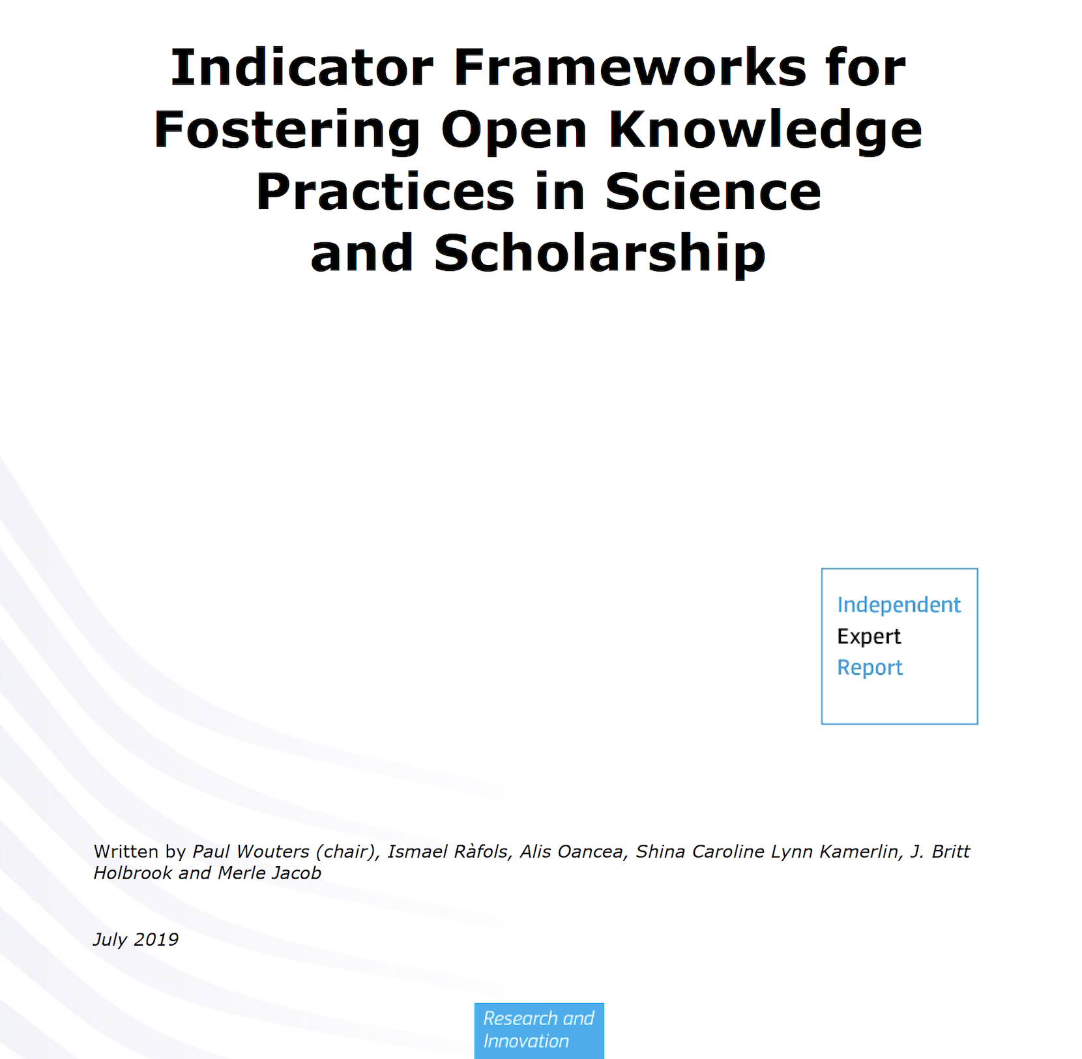

Slide 6
OSPP recommendations – research indicators and next generation metrics
Do not use journal brand or IF for individual researcher assessment as proxy for quality
Develop indicators that capture full range of contributions
Do pilots to check validity of these indicators as part of Horizon2020
Apply ORCID and develop CV best practices
All metadata should be open

Slide 7
Open Science Monitor
(in development)
monitor for Europe and global observatory of open science trends
reference point for the open science community
determine impacts of OS
structured analysis of policy relevant trends in OS
comprehensive
inclusive and open for comments

Slide 8
Rewards working group
Research Performing Organisations (RPOs) should be strongly encouraged to include OS practices in the evaluation of performance and of career development
Research Funding Organisations (RFOs) should be strongly encouraged to include OS practices in the evaluation criteria for funding proposals and as part of the assessment of the researchers.
The Open Science Career Assessment Matrix as central tool

Slide 9
Expert Group Indictors for Open Science: Key considerations
Open knowledge practices are the key issue (not open artefacts or outputs)
Open science is very diverse
Generic “OS indicators” are fundamentally in contradiction to the very concept of open science
Open science is very dynamic: tools come and go
Indicators are only useful if put in the right context and closely connected to the practices
Existing/developing metrics are partial and only relevant in a specific context

Slide 10
Key concepts
Stimulate the bottom-up development of next generation metrics in the context of the practices that they are meant to indicate
Indicator frameworks that guide the development and use of indicators
Tool libraries / kits / boxes that are developed bottom-up need to be harvested and made available
Do NOT try to develop or impose ”OS Indicators” top-down

Slide 11
Recommendations
Funding agencies, research performing organizations, publishers, and policy makers work together to prioritize a four-fold approach to open science:
creating novel infrastructures to enable effective and efficient knowledge sharing at all points of the research cycle.
building open knowledge practice capabilities in all scholarly communities.
investing in best practices and exemplary initiatives in knowledge sharing which are transformative in their field.
including these open knowledge practices in the reward and incentive systems at national and European levels and removing performance indicators that act as barriers to engagement.

Slide 12

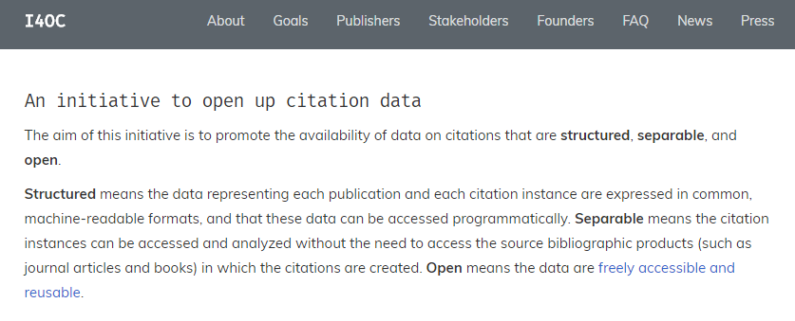
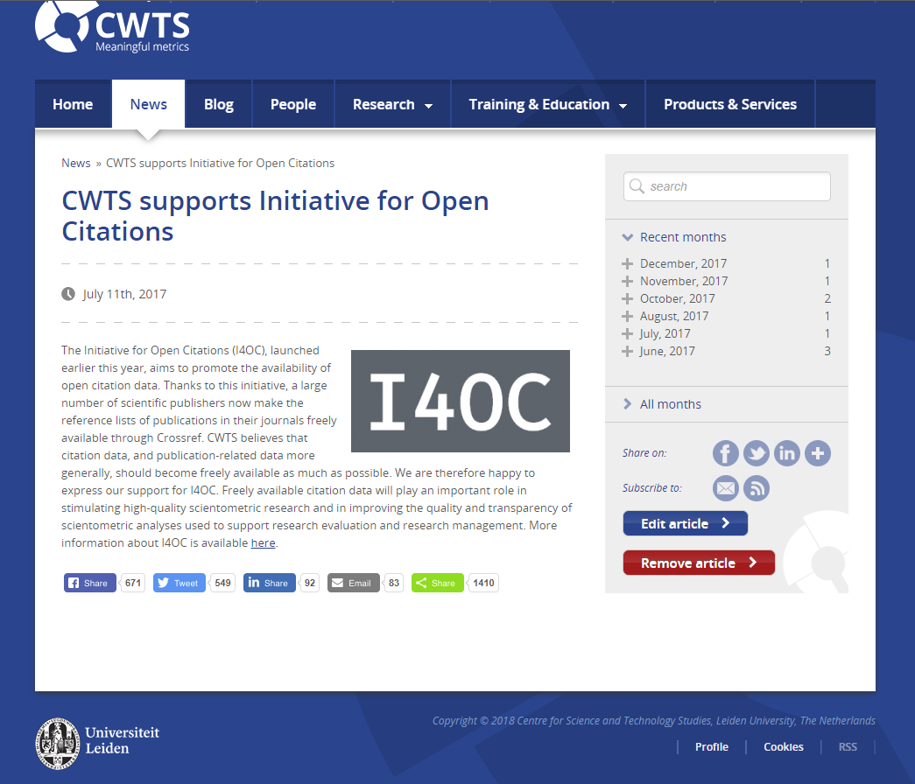
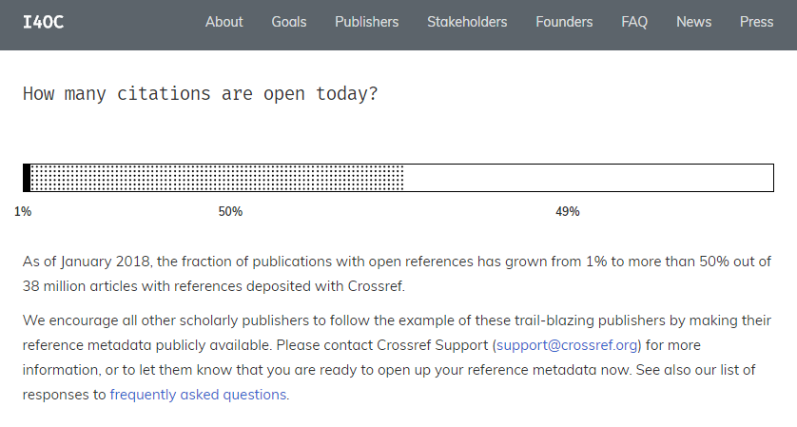
Initiative for Open Citations (I4OC)

Slide 13
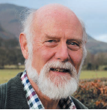
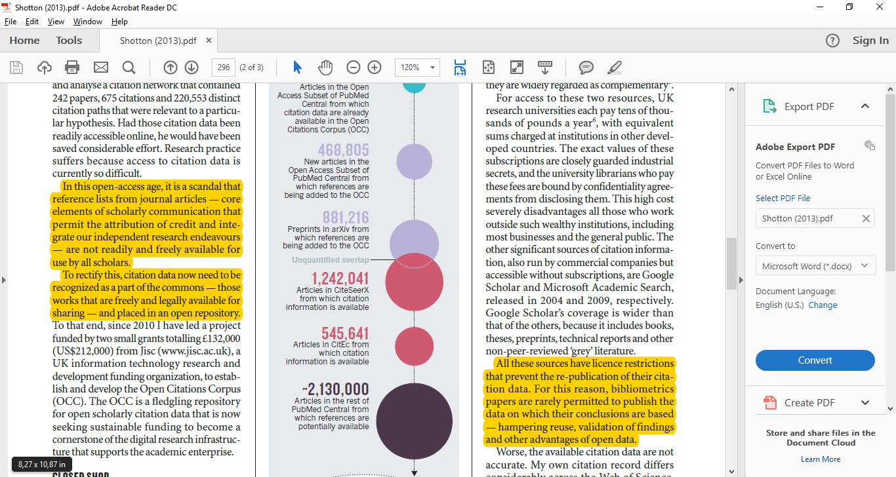
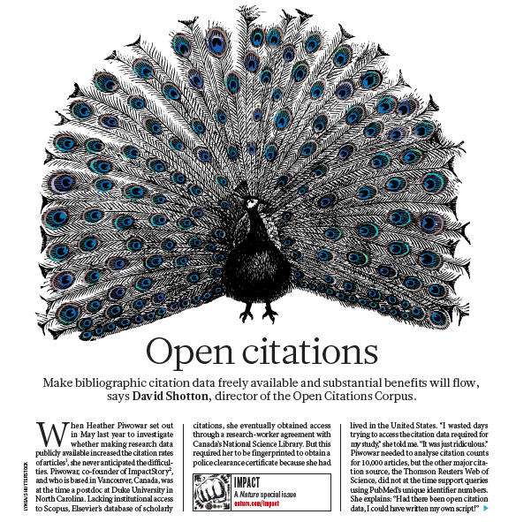
OpenCitations Corpus
Nature, 2013, 502, 295–297

Slide 14
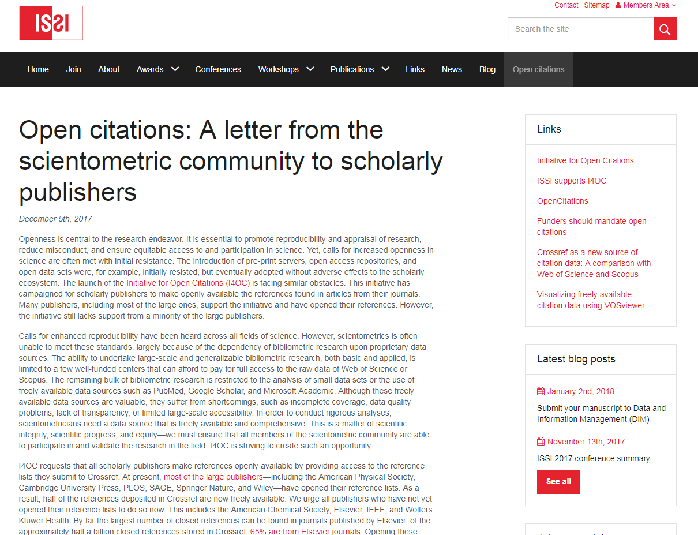

Slide 15
Stakeholder involvement

Slide 16
Evaluative Inquiry
Rethinking research excellence and academic quality.
Research quality is not just an academic issue, but relevant to policy, professional networks and societal domains.
Metric analyses offer limited understanding of reality. A portfolio of different methodologies offers additional perspectives.
Evaluations are often used as accountability tools. As such they don’t enable organizational learning. The evaluative inquiry aspires to both.

Slide 17
The Evaluative Inquiry’s method
1. Exploration | What are the central issues and questions of the project? Document analysis and conversations with client.
 | Design of research approach and specification of combination of methods.
2. Data collection and analysis | # Contextual Response Analysis (Prins, n.d.); contextual scientometrics (Waltman & van Eck, 2016); bibliographic coupling; co-citation analyses; Area Based Connectedness (Noyons, 2018) # Interviews with researchers and stakeholders about institutional organization, academic themes, output and impact.
 | Workshops – data collection for SWOT analysis and/or testing of hypotheses.
3. Reporting | Analysis of institutional organization as well as the relations between academic themes, output and impact. SWOT. Suggestions for self-assessment.

Slide 18
PThU data collection and analysis
Contextual Response Analysis: (online) analysis of users of research results to establish which (potentially unknown) users are being reached.
Interviews with employees and stakeholders about the institutional organization and impact pathways: connections between themes and ambitions; mobilization of people and resources; outputs; impact on societal, academic and professional domain.
Workshop to test hypotheses and collect material for SWOT.

Slide 19
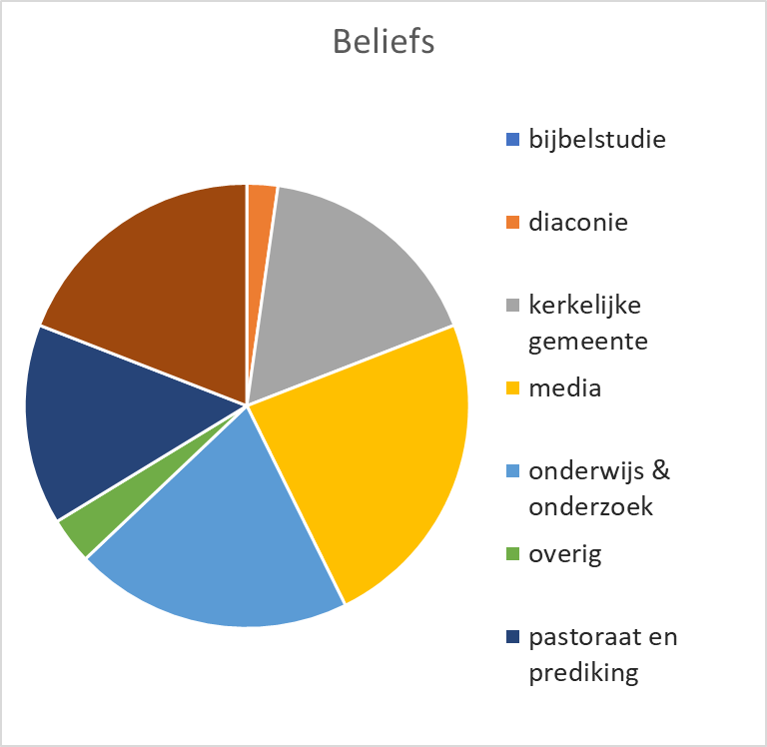
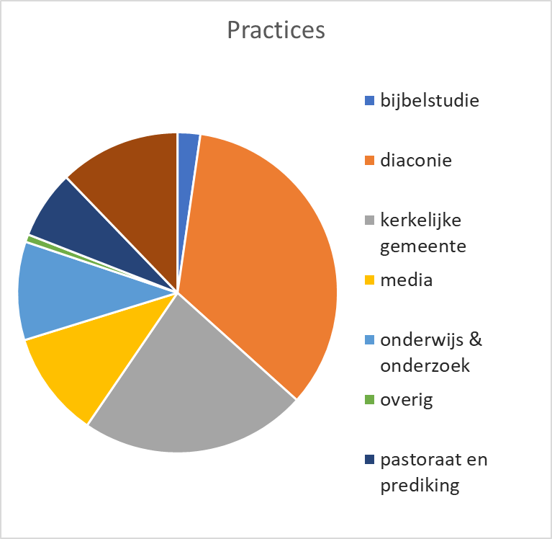
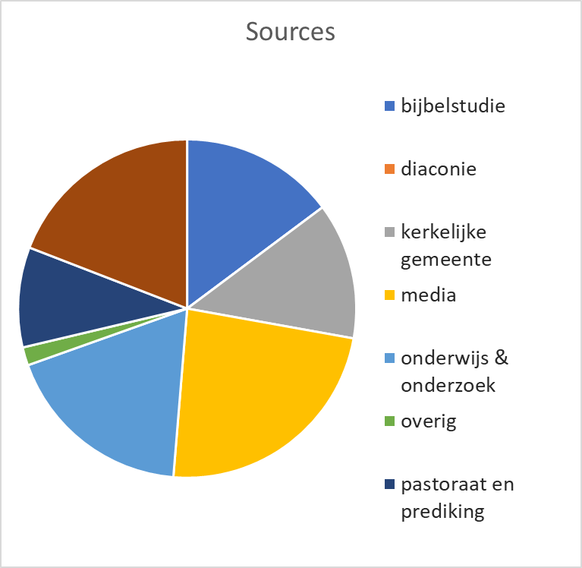
CRA analysis: different profiles…
Research teams have distinct profiles

Slide 20
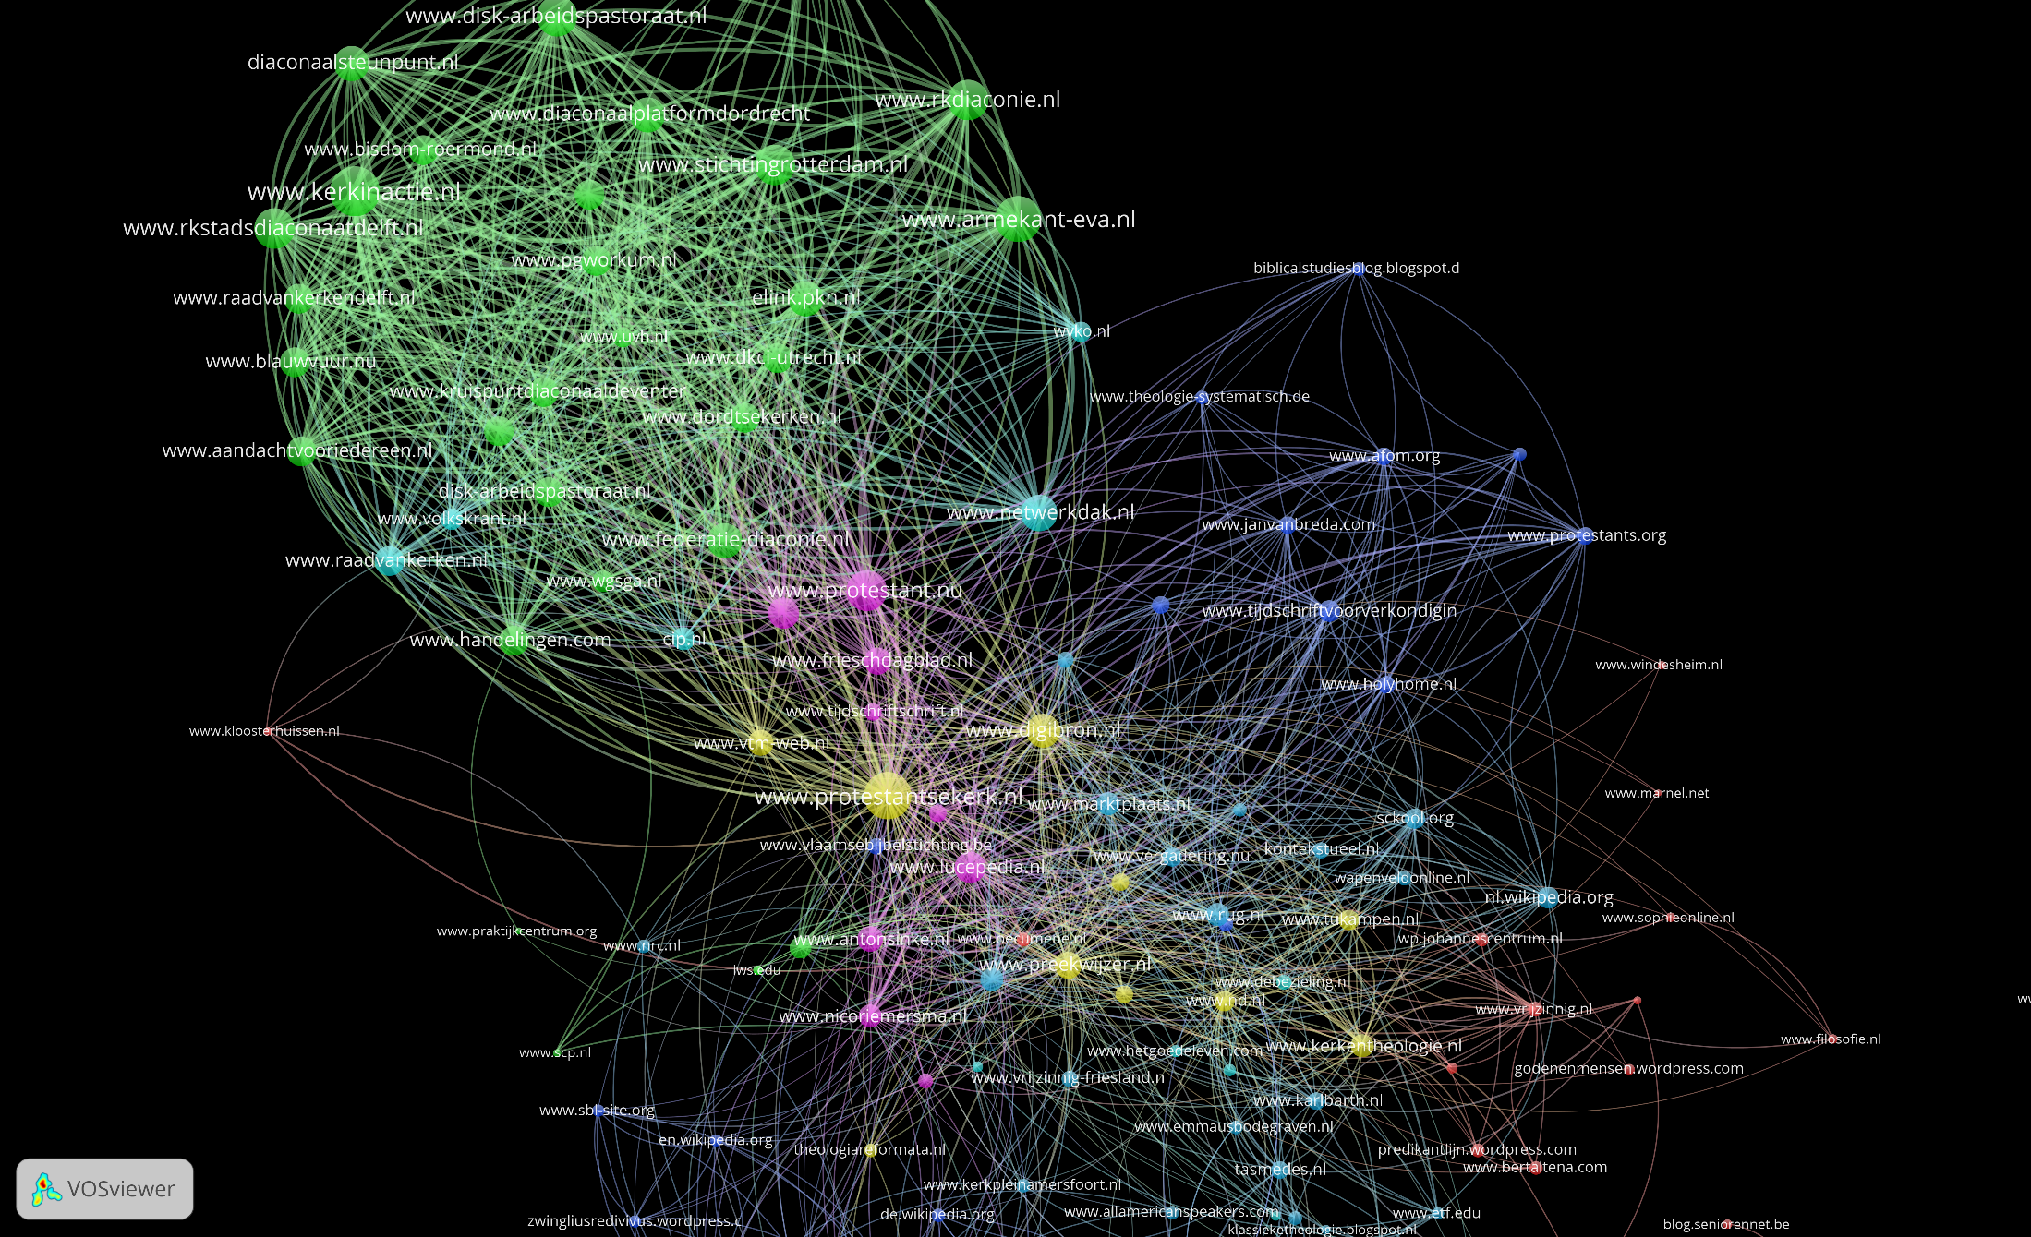
And affinities
PThU staff connected in co-citation map

Slide 21
Results evaluative inquiry
Detailed analysis of:
  Evolution and transformation of research topics
  Possibility to diversify and protect local excellence
    Translation knowledge in outputs, outcomes, impacts
    Distinction between different phases of generating impact (scientific, societal)
  Involved networks of actors and types of resources
  Influence research on academic and societal networks and fields

Slide 22
Characteristics
  tailor made and modular
  content oriented, learning capacity central
  mixed methods approach
  Indicators as ‘proxies’ for narratives
Makes visible:
  mission and research topics
  communication and collaboration patterns
  all types of output and results
  conditions for research and infrastructure
  process determinants (eg open science, gender diversity)

Slide 23
What can you do with it
Can serve as a starting point to develop or refine the missions of the organization
Based on the views and experiences of researchers and users (bottom up)
Articulating what is already going on
And identifying new possibilities
    New audiences, existing ones
    Ways of communication next to books and articles
    A clearer structure of the organization, in terms of programs, centres and projects

Slide 24
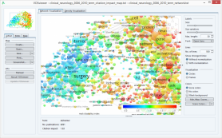
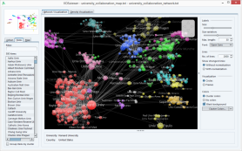
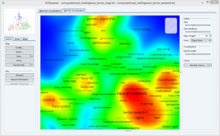
Map interactions rather than output
Innovation interactions take place in heterogeous networks of actors
Science is “applied” in translation processes: science is not immediately useful
Mapping impact means mapping these interaction processes rather than isolated impact results

Slide 25
Context Response Analysis (CRA)
Tracing use, classifying the user in society, science, news and politics
  Goal: Enabling evaluation in terms of learning from past performance
  Developed in concurrence with SIAMPI, ERiC
  Method: formalized searches in Parliament, LexisNexis, Google & Bing, GS
  Result: profiles of research units, identified stakeholders
Flexibility
  Operationalize the method to address issues and questions in the evaluation
  Identifying meaningful interactions or groups of stakeholders

Slide 26
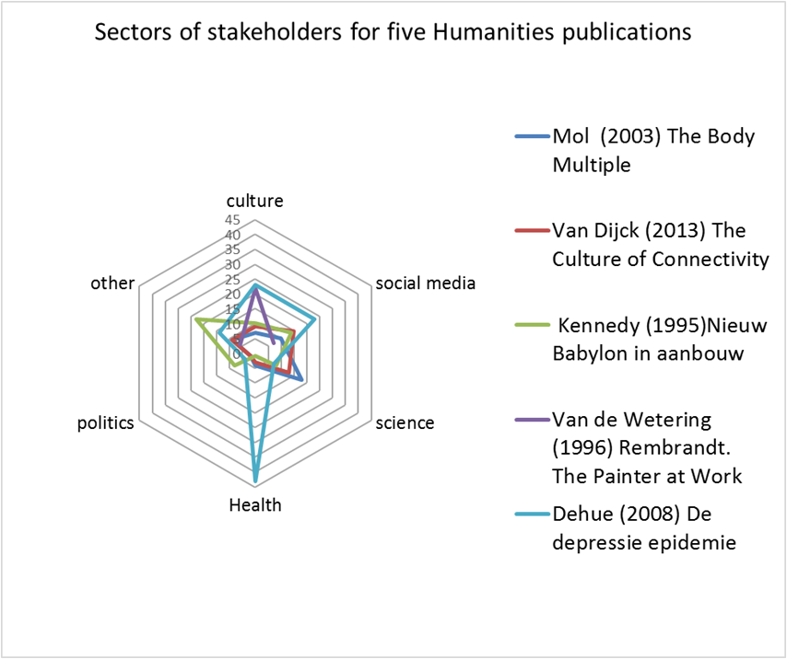
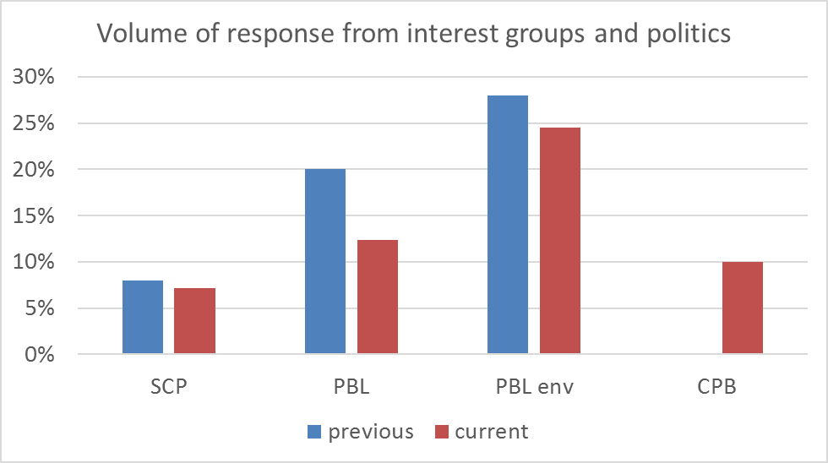
CRA types of outcome
Hybrid outcomes of research: combined academic and societal interest

Slide 27

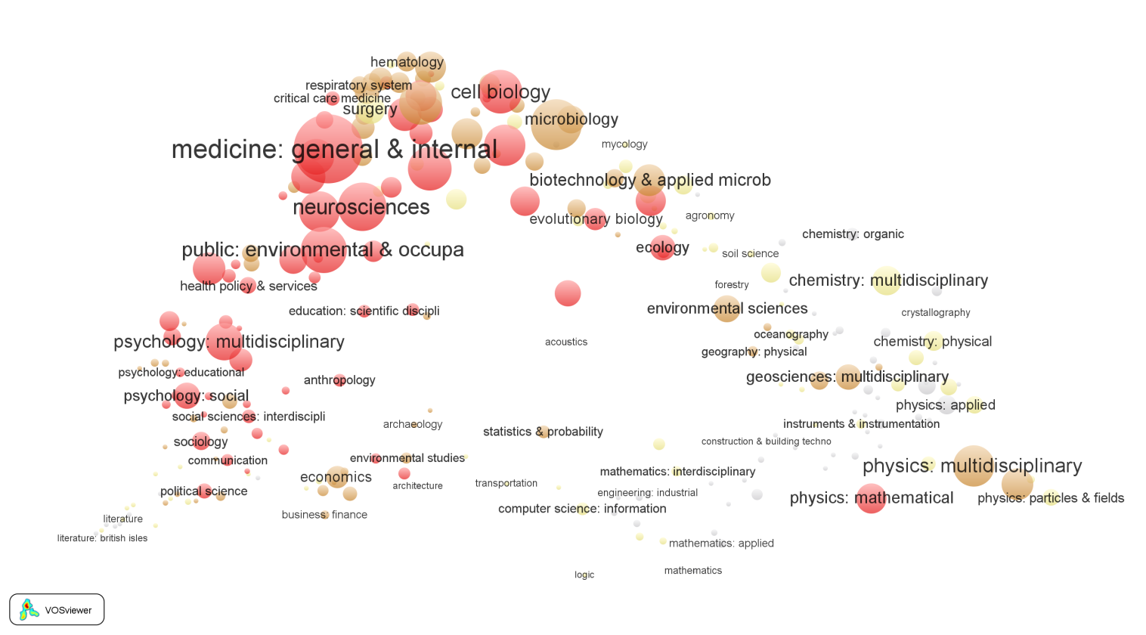
http://dx.doi.org/10.1108/AJIM-12-2014-0173
Coverage by fields
Some relevant patterns:
  Twitter: stronger in Social Sciences and General medicine, weaker in Natural Sciences and Humanities

Slide 28
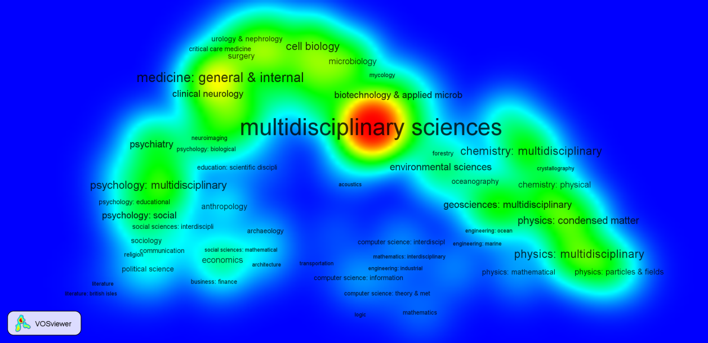
http://dx.doi.org/10.1108/AJIM-12-2014-0173
Coverage by fields
Blogs and news media have a strong focus on multidisciplinary journals!

Slide 29
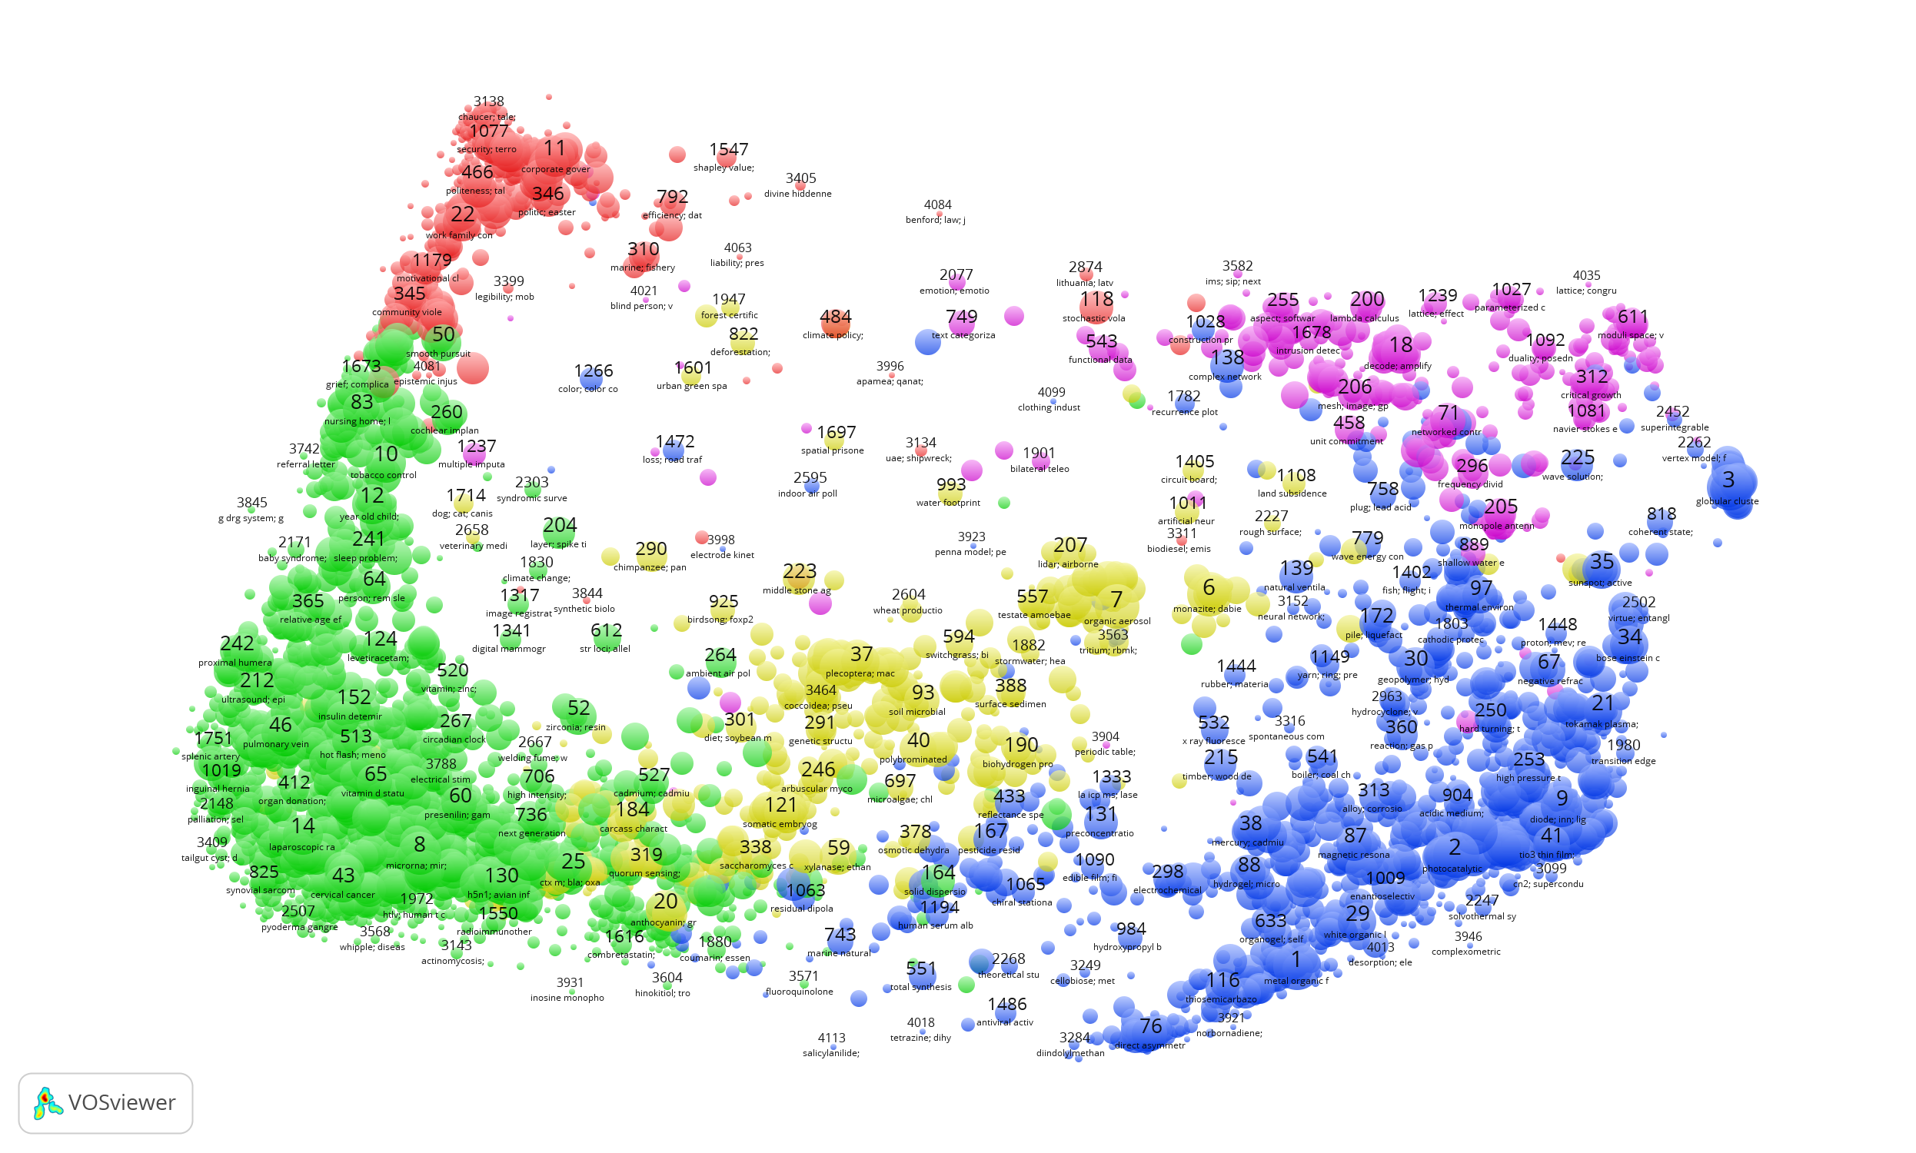
Twitter thematic landscapes
Social Sciences & Humanities
Mathematics & Computer Science
Life & Earth Sciences
Physical Sciences & Engineering
Biomedical & health sciences

Slide 30
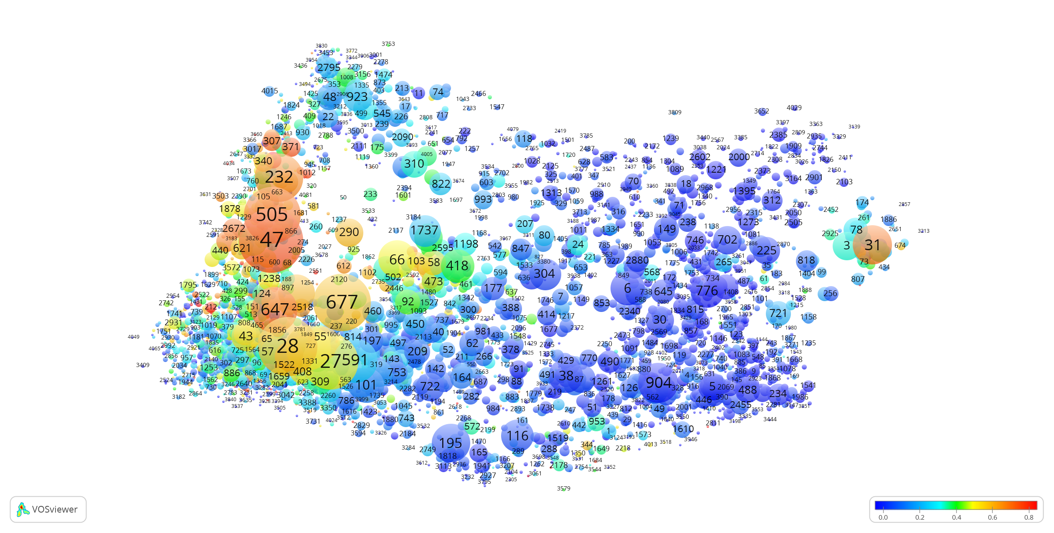
Twitter thematic landscape – Africa
Prop. Publications tweeted
Interpersonal
violence
Homosexuality
Maternal mortality
AIDS
Higgs boson
Infant
AIDS

Slide 31
Thank you for your attention

